Slide 1
Supervised Learning

Slide 2
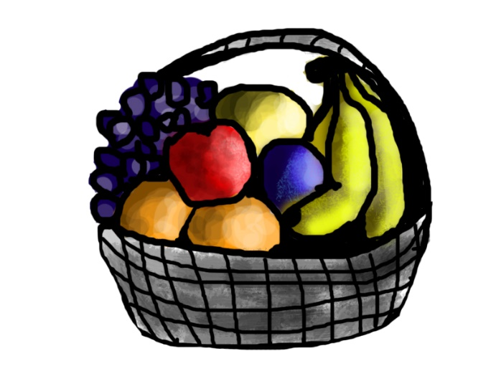
Supervised learning
Supervised learning as the name indicates a presence of supervisor as teacher.
In which we teach or train the machine using data which is well labeled that means some data is already tagged with correct answer.
After that, machine is provided with new set of examples(data) to produce correct outcome from labeled data.
For instance,
Suppose you are given an basket filled with different kinds of fruits.
Notes:
https://www.geeksforgeeks.org/supervised-unsupervised-learning/

Slide 3

Supervised learning
Now the first step is to train the machine with all different fruits one by one like this:
If shape of object is rounded having color Red then it will be labelled as –Apple.
If shape of object is long curving cylinder having color Green-Yellow then it will be labelled as –Banana.
Now suppose after training the data, you have given a new separate fruit say Banana from basket and asked to identify it.
Since machine has already learnt the things from previous data and this time have to use it wisely.
It will first classify the fruit with its shape and color, and would confirm the fruit name as BANANA and put it in Banana category.
Thus machine learns the things from training data(basket containing fruits) and then apply the knowledge to test data(new fruit).

Slide 4
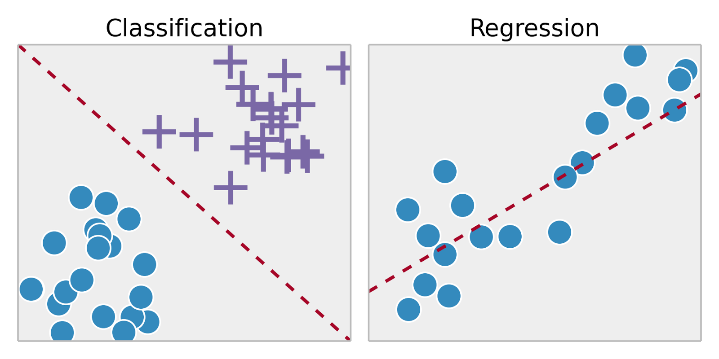
Supervised learning
Classification: A classification problem is when the output variable is a category, such as “Red” or “blue” or “disease” and “no disease”.
Regression: A regression problem is when the output variable is a real value, such as “dollars” or “weight”.

Slide 5
Thanks

